Slide 1
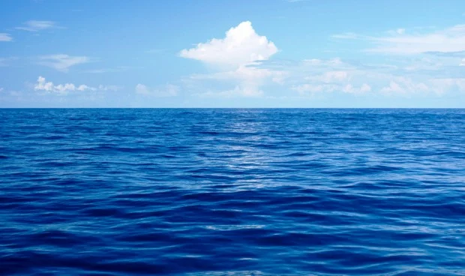
WATER CREATES CIVILIZATION.

Slide 2
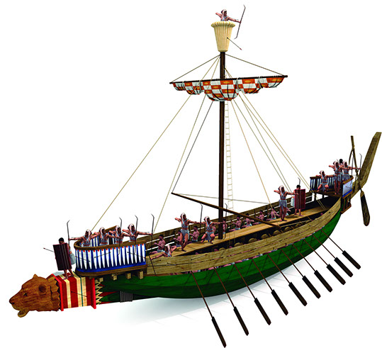
THE SEA IN ANTIQUITY
If we go back to antiquity, the first conquerors (the Phoenicians) arrived by sea.
The Mediterranean Sea allowed the political, economic and cultural expansion of the Greek and Roman civilisations. ... This natural resource represented more than just food for subsistence, it was a space that allowed communication and cultural interrelationships between the various peoples who settled there.

Slide 3
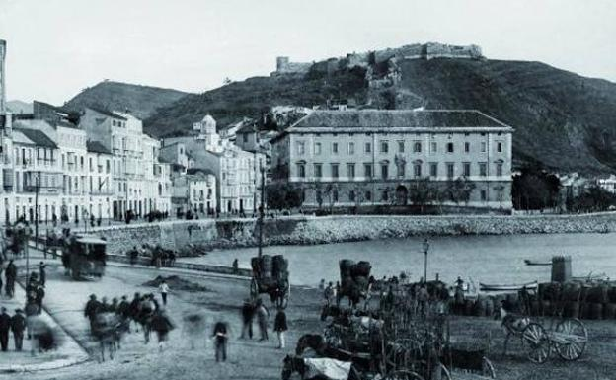
Malaga was conquered to the nearest areas of the Mediterranean by sea.
After the town of Malaga was conquered by the Arabs, the walls began to be crumble and the Puerta del Mar was left further and further behind. A small customs house was built in the area.

Slide 4
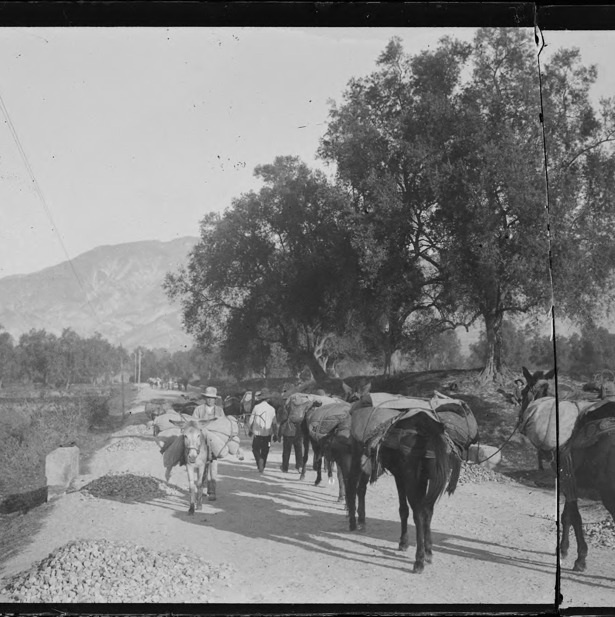
The sea was the main mean of communication. In Coín, before cars were invented, there were muleteers who took fruit, vegetables... to the port of Malaga so that the ships could take goods to Valencia, Murcia, Cadiz... On the other hand, most of the fish consumed in Coín came from the capital city.

Slide 5
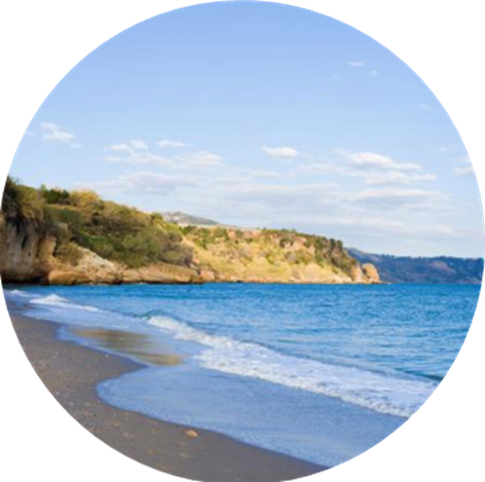
The importance of the Mediterranean Sea for Malaga
The Mediterranean Sea is very important for Malaga.
It is a warm sea with a characteristic homonymous climate and its own culinary style. These factors attract millions of tourists from other parts of the world to the Malaga coastal area

Slide 6
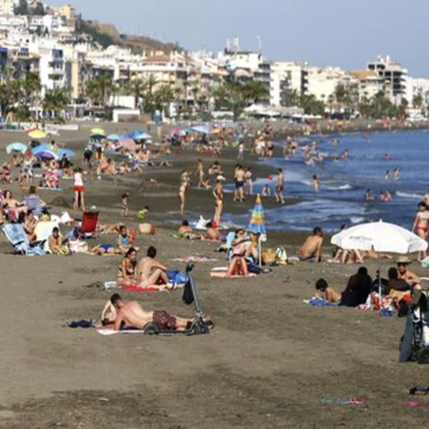
Coastal tourism in Malaga
The Costa del Sol is one of the most important tourist areas in Spain, concentrating around 35% of tourism in Andalusia and hosting more than 17 million hotel overnight stays per year.
In 2019 it welcomed more than 13,000,000 visitors, enjoyed 300 days of sunshine, it has 150 kilometers of coastline and beaches and is one of the most important tourist, economic and demographic centers in Spain.

Slide 7
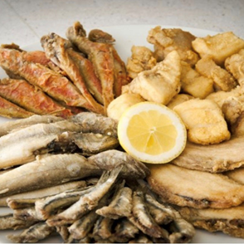
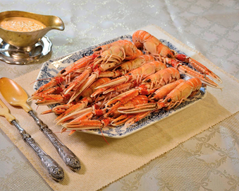
Gastronomy from the beaches of Malaga
The sea in Malaga offers us a great variety of fish such as anchovies, sardines, squids etc. which are usually fried. This is the symbol of a cuisine of simple preparation but of exquisite palate. It is worth mentioning the “espeto” which are sardines grilled on a cane skewer over the heat of an open wood fire.

Slide 8
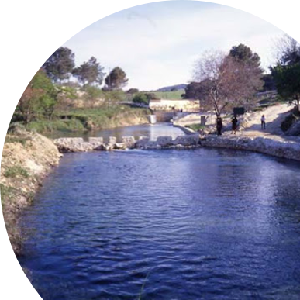
EL NACIMIENTO.
The spring of “El Nacimiento” is located in the south of Coín, in the area known by the same name. It is one of the most fast-flowing springs of Sierra Blanca, with an average volume of 350 litres/s, much diminished at present by nearby pumpings. It is the place from where the water that supplies the town and the main rural areas emanates.

Slide 9
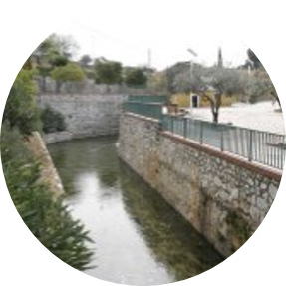
In times of drought, the main concern of the citizens is that the stone from which the water is born does not dry up, and there is even a legend that if this stone was moved, no more water would come out of this spring. This emblematic place is currently undergoing major changes to be turned into a recreation area.

Slide 10
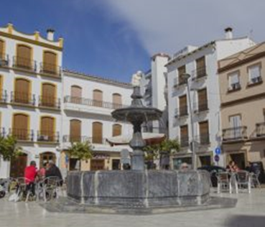
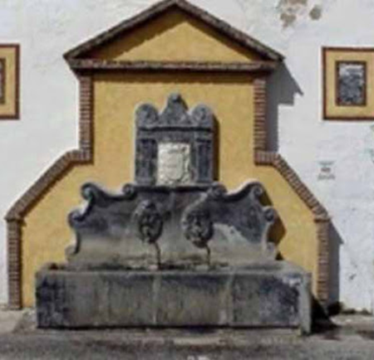
The fountains of Coín
Coin is a town where the water is very important.
In Coin there are many different fountains. Many of them are made of blue marble extracted from Coín´s mines.
The main ones are those of the Alameda, the Plaza del Pescado and the Parque de San Agustín. They are also made of marble.

Slide 11
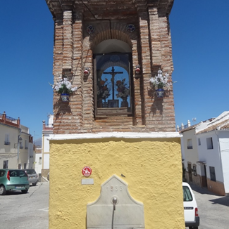
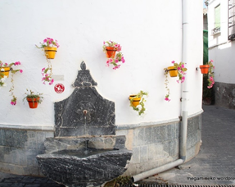
The fountains in Coín are not only used to supply drinking water, but also as decorative elements.
In Coín the importance of water is related to religion and architecture

Slide 12
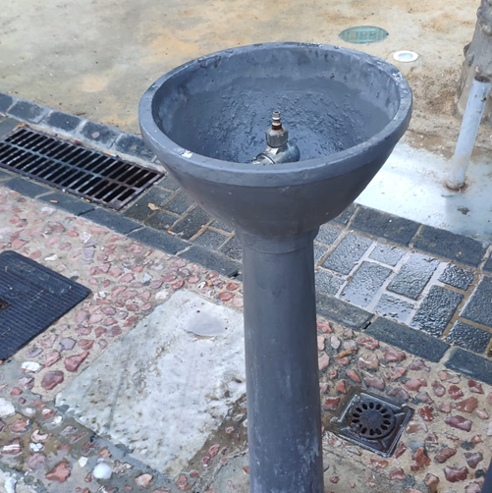
Cirilas of Coín
There is something funny about the name of the fountains, like those in the picture, in Coín. They are called “cirilas”.
Almost all the Cirilas are over springs so when you are walking you can drink refresh water

Slide 13
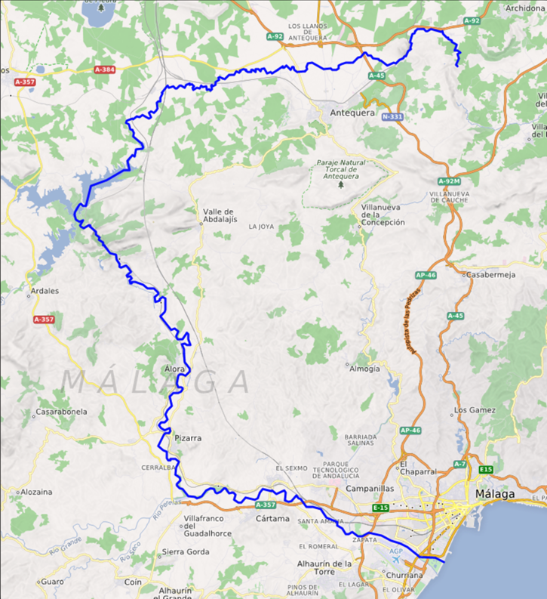
THE GUADALHORCE RIVER
The Guadalhorce river is the largest river in Málaga. It is 154 km long and it occupies half of the Malaga province.
The origen of its name is Arabic and its source is in the Sierra de Alhama.
It has different tributary rivers, among them: Turón, Guadalteba, Grande and Campanillas.
It flows into the Mediterranean sea, in the west of Malaga city.

Slide 14
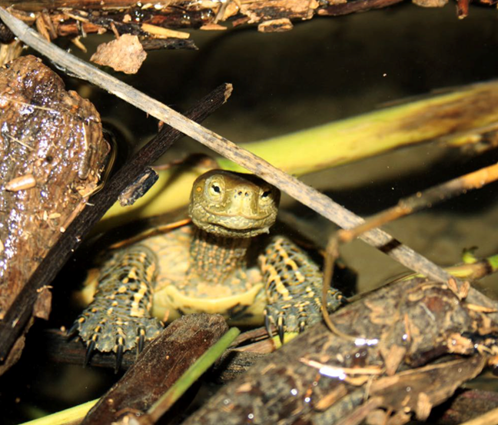
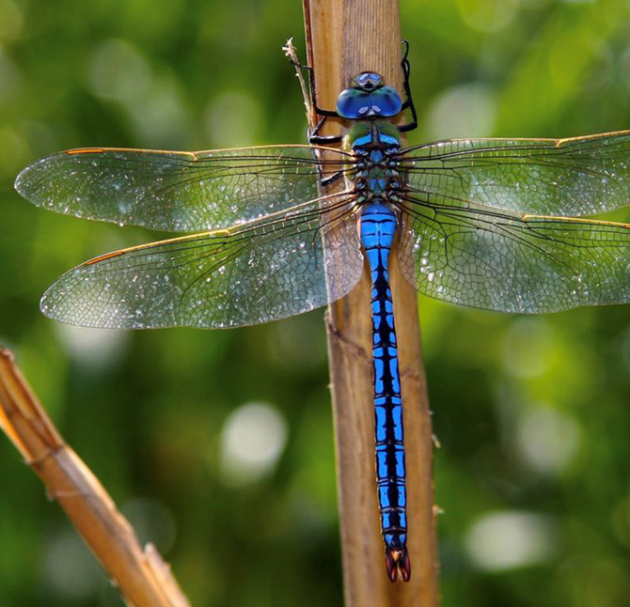
Biodiversity
It has important animal species,
such as fish, turtles, dragon flies and birds that are protected by the European Union.
For this reason it is a Special Area of Conservation (that is a river of great environmental interest for the conservation of diversity). It is integrated into the Natura 2000, a network of nature protection areas.

Slide 15
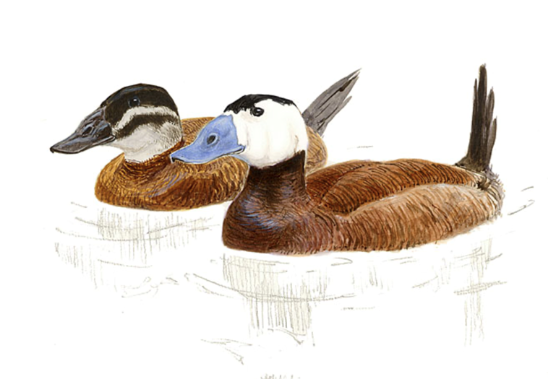
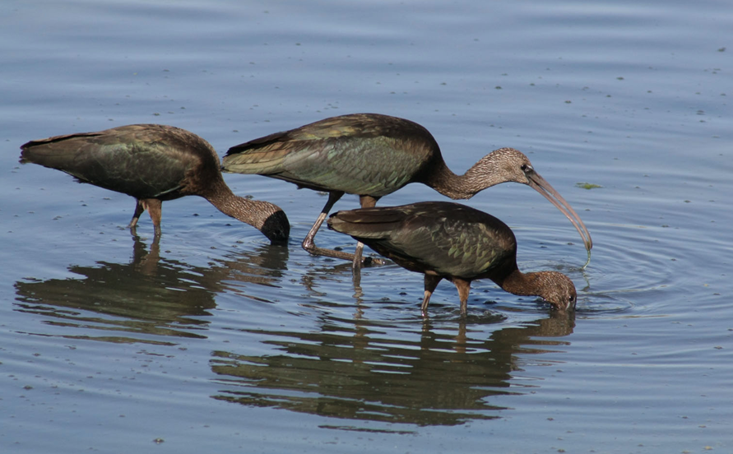
Mouth of the river Guadalhorce
This is an important area for seabirds and other waterbirds.
More than 260 different species of birds have been watched.
We can enjoy the White headed Duck (Oxyura leucocephala), the Pochard (Aythya ferina), the Little Bittern (ixobrychus minutes) or the Night Heron (Nycticorax nycticorax)

Slide 16
THANK YOU

