Slide 1
Plastic in Swedish waters

Slide 2
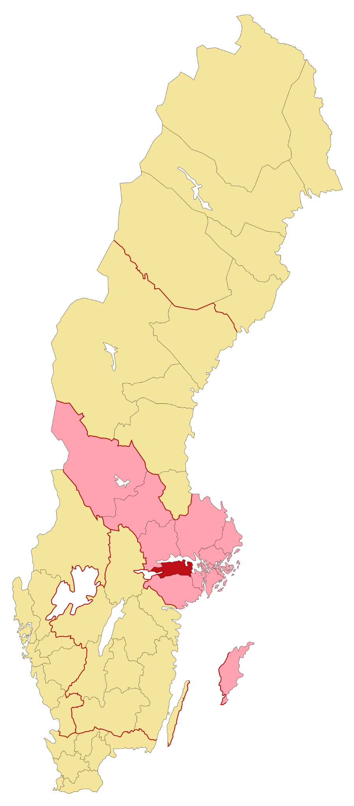
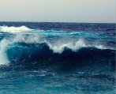
Introduction
Sweden:
Scandinavia
Eskilstuna Södermanland
East sweden
Sweden produces 990.000 tons plastic /yr.
Approx. 10% lakes.
How big of a problem is the plastic pollution?:
Can reach irreversible levels
Might not notice affect you
What this presentation will be about:
Much plastic is thrown in our waters
Problems in lakes
Problems in seas
Potential solutions

Slide 3
Problems in lakes
Plastic, is the biggest problem.
Free divers- Searched- found 15-50 kg plastic
Each DV session.
To much plastic.
Nanoplastics & Microplastics
Both are found in all (waters)
Even in (waters) km away
Nanoplastics More dangerous
Humans end up consuming it
= dead cells, severe allergic reactions.
= bad health.

Slide 4
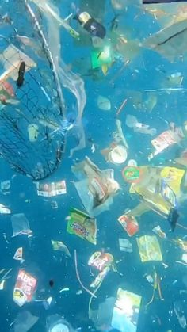
Problems in the Seas
-Plastic in the seas
8 tons of plastic
Stuck,wounded or die
-Plastic
Plastic Particles
Microplastics
(Fish eat, we eat)
990 000 tons
300 000 tons
-Danger
- Fish and Fishing nets
Impact on the marine diversity (50 years)

Slide 5
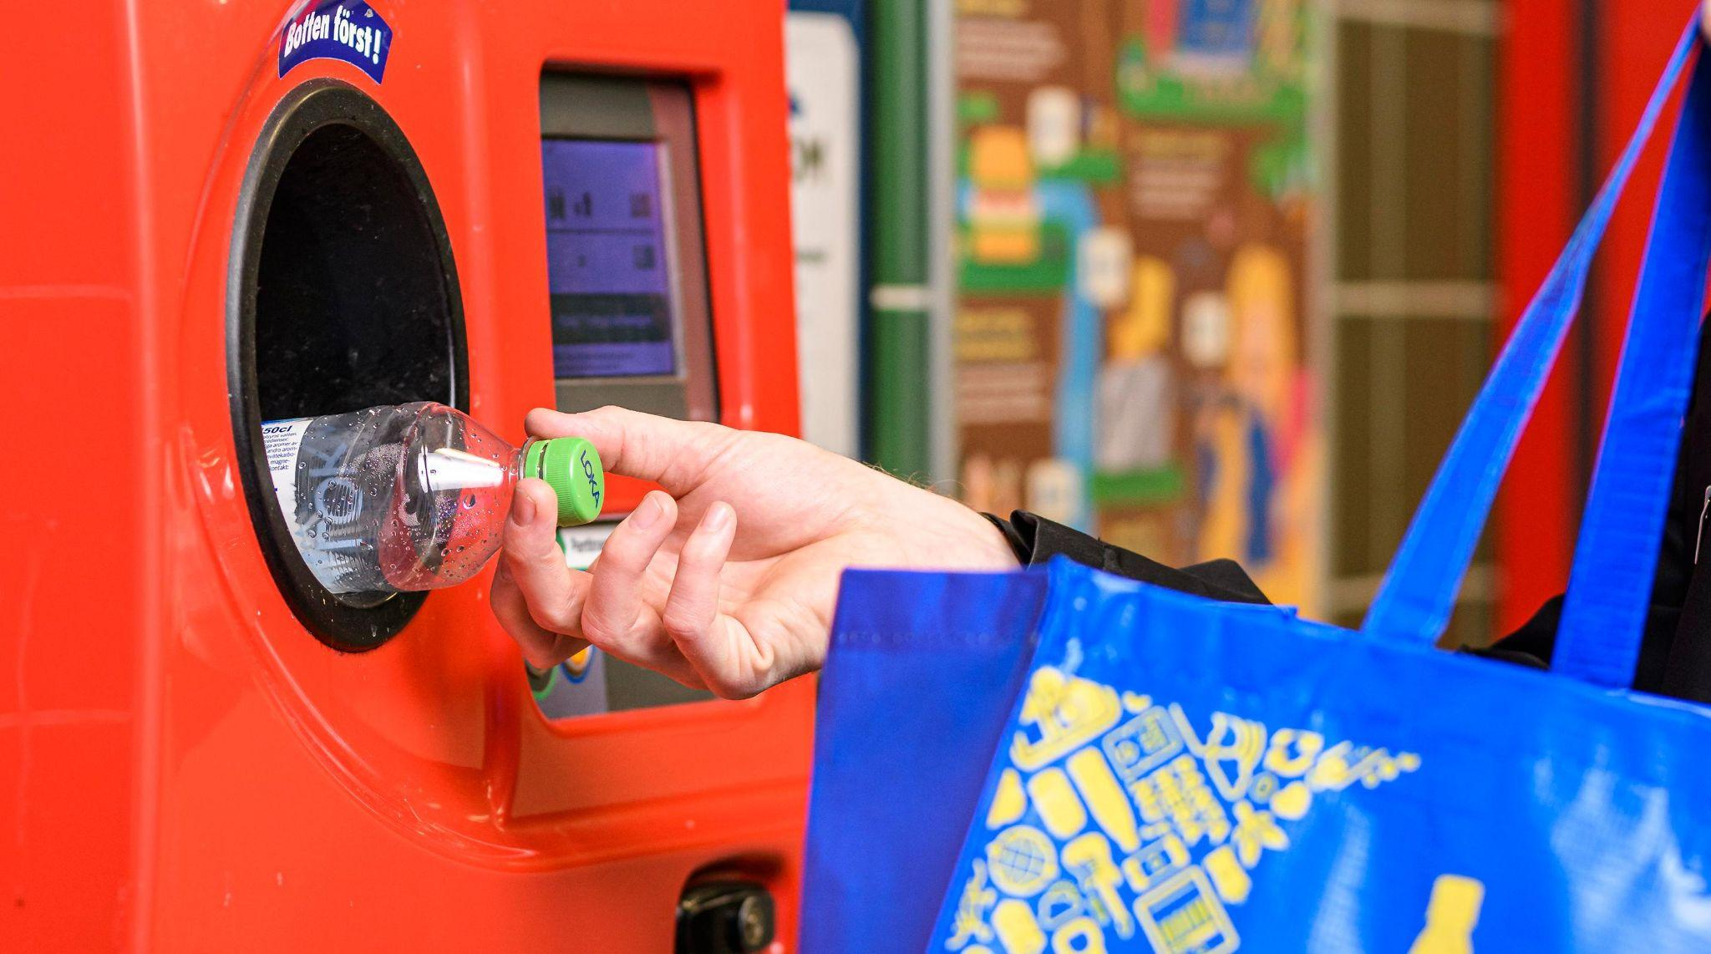
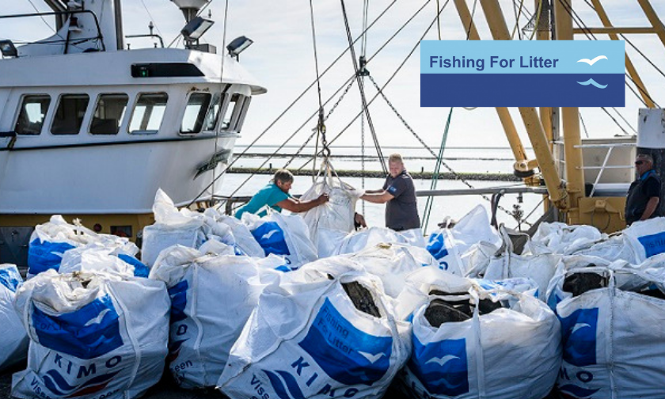
Solutions to these problems
Plastic
Reusable items
The “pant” system
Volunteering
Plogging, school
47 percent
Recycled
Cleaning beaches
KIMO group
Eat less fish

Slide 6
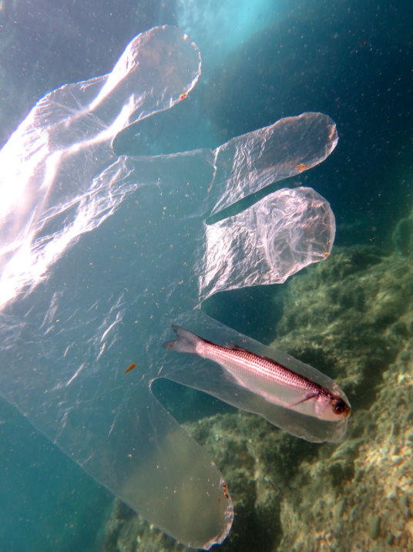
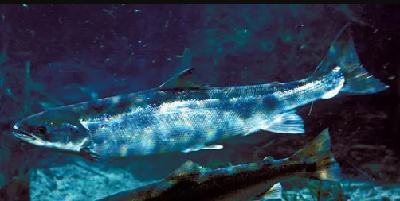
Nanoplastics and microplastics
Plastic amounts in waters and production of plastic
8 million tons of plastic produced in the world every year.
Sweden produces 990 000 thousand plastic.
47% of plastic in Sweden is recycled.
Freedivers findings
Nanoplastics and microplastics
Plogging
“Pant”
Solutions
Reusable material Cleaning beaches and lakes

Slide 7
Thank you for your time!
Have a nice day

