Slide 1
Global Warming
Sweden - Eskilstuna

Slide 2
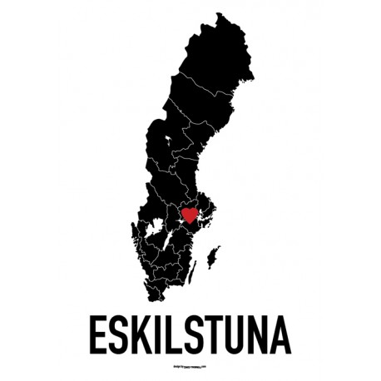
Introduction to Sweden
Notes:
Sweden is a country located in the north of europe. One of the beautiful things about Sweden has always been noticeable change in seasons, winter melting into spring then Summer, the wonderful colours of Autumn leaves the biting chills of winter.
Usually… but because of to the climate change a lot of things become different from year to year. We are going to talk about some of the consequences from the climate change in this presentation.
We are going to talk about why those things happen and show pictures connected to the disaster we talk about.

Slide 3
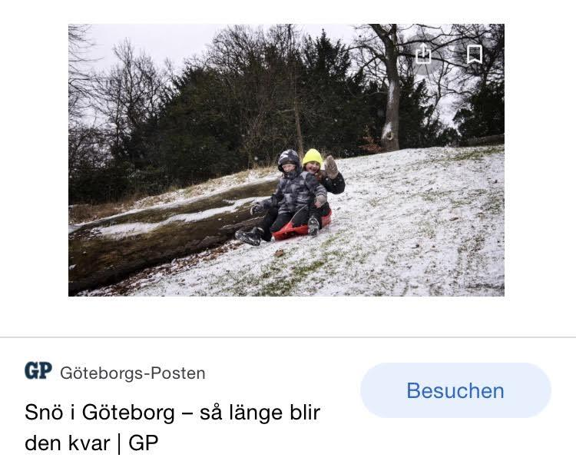
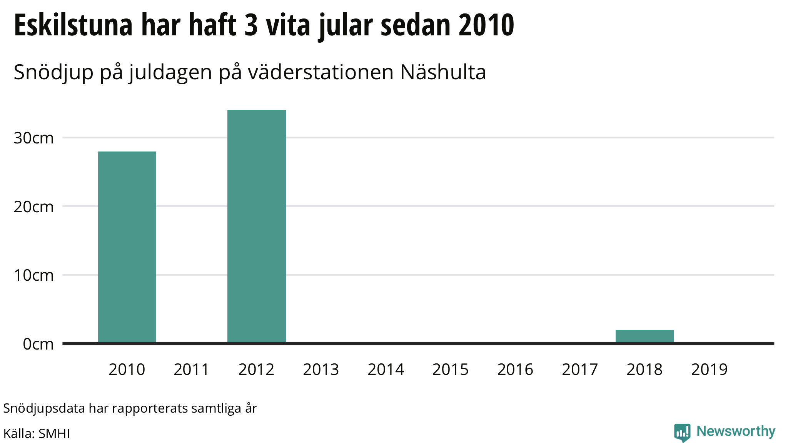
Temperature change
Notes:
The temperature change is the main problem to some of the problems that we get. It is really noticeable because the season change length and weather. Some of the bigger problems the changing temperature creates are forest fires, changing season and rising water because of the ice melting.

Slide 4
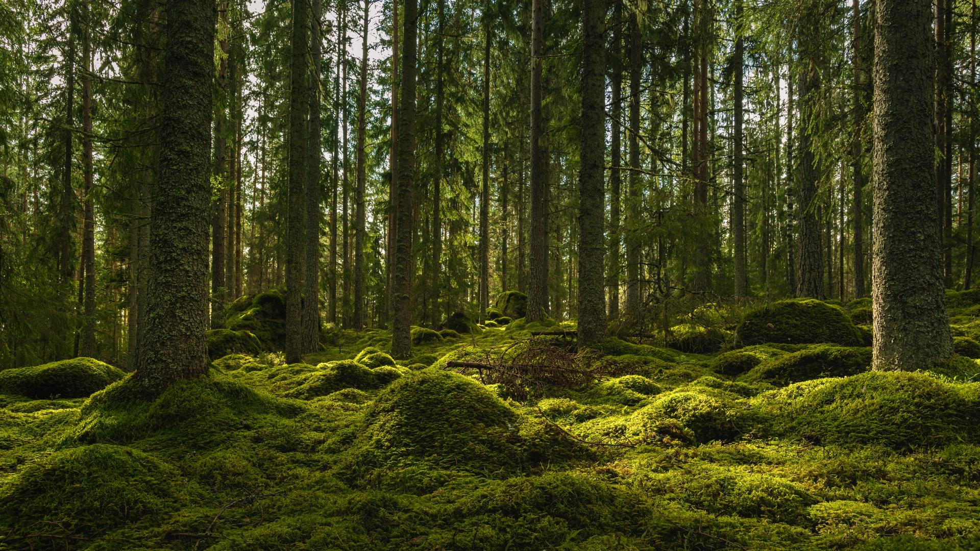
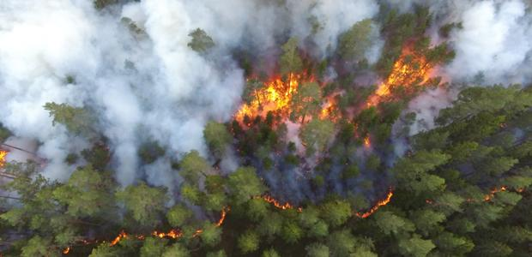
Forest fires.
Eskilstuna
Today
2018.
Especially.
Emissions
34,6.
Temperatures.
2010 - 72,7 kha (58%) - 2020 - 2,37kha.
🌲
🔥
In some years
Notes:
The worst year of forest fires was 2018 during the end of spring and during the summer. During this period there were a lot of places where woodland areas burned down, especially in the southern and middle parts of the country. The reason why this happened is first of all thanks to the emissions of carbon dioxide. Because global warming has become worse year after year. Another reason why this is happening is also because the ground gets dry due to the higher temperaturer. Sweden even got a warm record of 34,6 degrees celsius in 2018.
As my friend said before, the temperatures have risen year after year and after some time it has developed into extreme weather and natural disasters such as forest fires. In 2010 the forest area in our hometown, Eskilstuna, was approximately 72,7 kha which extended over 58% of the land area, but in 2020, our city lost 2,37 kha of tree cover. This means that if we still are at this rate, all of our forest could be gone in less than 40 years. The wind has also risen over the years thanks to the global warming.

Slide 5
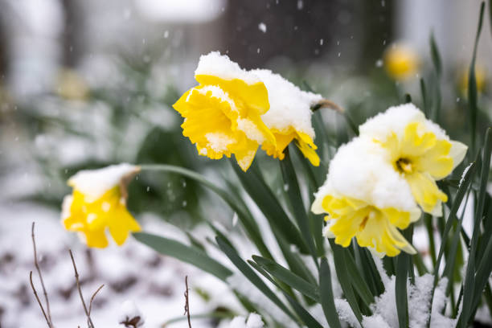
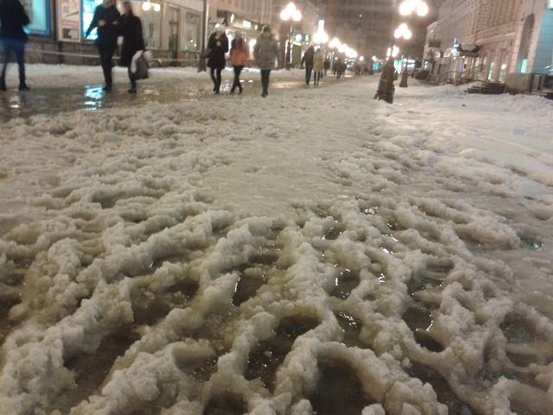
Changing seasons
Notes:
Due to the rising temperature the ice in the arctic is melting. It’s affecting the north of Sweden which is covered in snow most of the time. But this also affects our hometown with the seasons blending together. For example the winters are getting shorter and precipitation periods longer.
The summers has also been extremely hot and new heat records are broken each year. As you can see the weather is turning strange and inconsistent. With unpredictable weather wildlife and plants will suffer.
With climate change, the duration of snow cover is expected to reduce. In the southern parts of Sweden, long-lasting snow cover will probably become rare.
Groundwater is also reducing because of the hotter climate. You can already see the change in Öland where people had to start saving water, in the middle of the winter. With less damp earth, farmers are also forced to water more. This becomes a problem due to the water shortages and dryer climate.

Slide 6
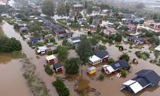
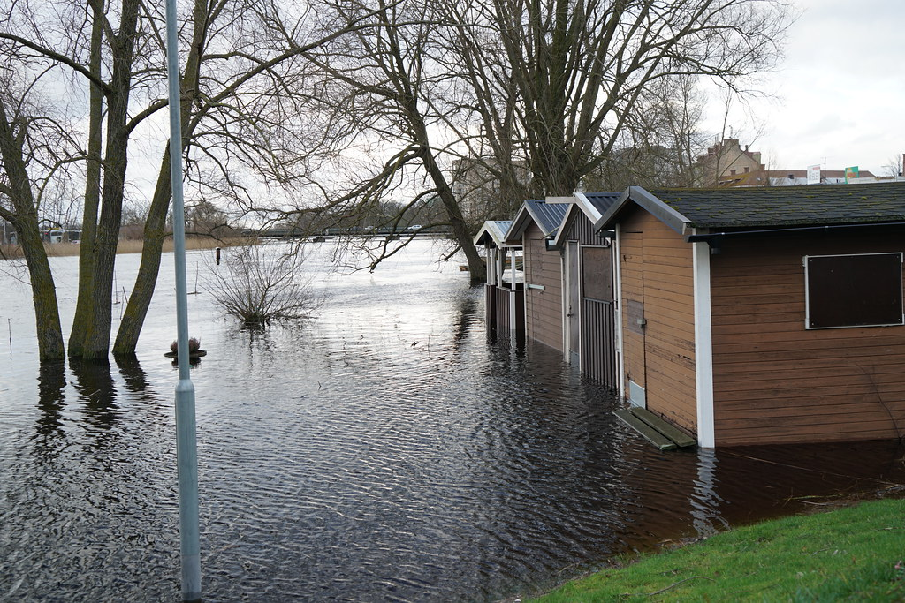
Flooding

Slide 7
Conclusion
Increasing Temperatures - Sweden.
Flooding - destruction.
Fires - dryness.
Season changing - disaster.
Notes:
In conclusion, with increasing temperatures Sweden's water levels will rise, which leads to flooding, flooding destroys roads, houses and farm land.
So in the future we would have less farmland leading to food shortages (short-edges). It would also lead to us needing to rebuild roads and build houses and for that we would have to take more materials from Swedish forests.
Forest fires in Sweden are becoming more common due to the heat rising which also ruins our forests, the fires are happening because of how dry the ground has become, most summers outdoor barbeques are forbidden because of the risk of fiers.
There has also been a major change in the season which leads to them blending together.

Slide 8
Thank You For Listening!
By: Anton, Nina, Katharina, Astrid, Cassandra

